Slide 1


MS PowerPoint Assignment on GitHub
ICA

Slide 2
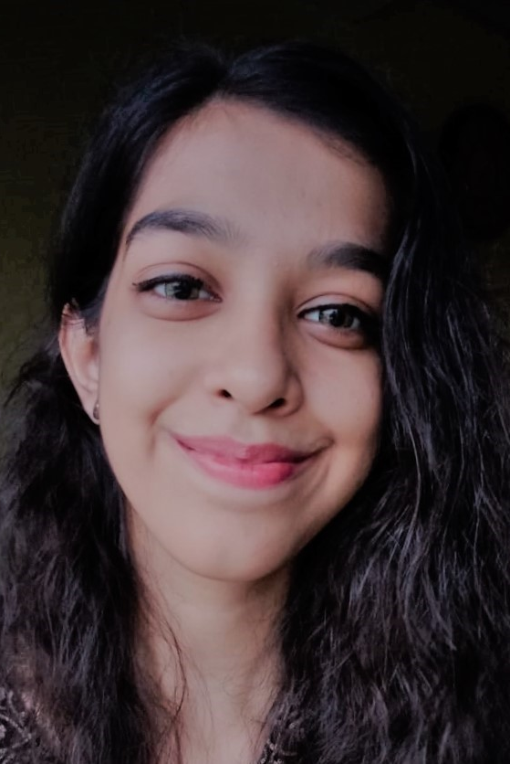
ZAHRA MUSTAFA
A student at Institute of Business Administration.

Slide 3

I was born in Karachi on December 10th, 2003. My star is Sagittarius and I have quite some interest in astrology. I am an academic ace who has won plenty of debate and writing competitions. I am a good swimmer and I also play chess. I am also doing some side courses on search engine optimization.

Slide 4
Qualifications
Matriculation from Karachi public school
Pursuing Bachelors in Business administration at institute of business administration.
Intermediate from sir Syed government college

Slide 5

Soft Skills
Communication skills
Time management
leadership
Problem solving
Teamwork

Slide 6

Hard Skills
content writing
Academic writing
Presentation skills
Technical understanding of seo

Slide 7
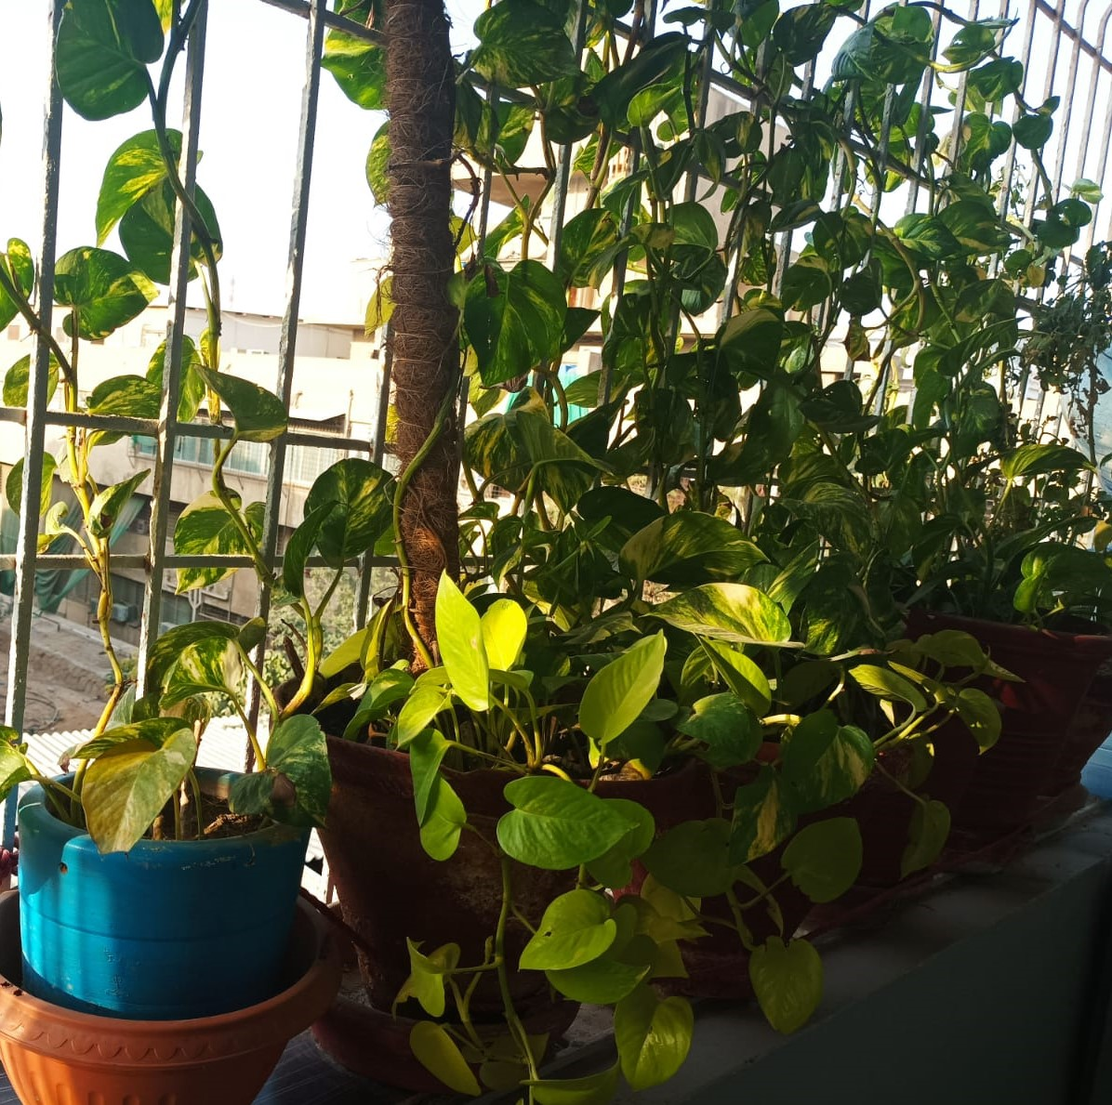
Hobbies
Reading books
Gardening
Archery
Korean dramas

Slide 8




Treasures in my collection
This Photo by Unknown Author is licensed under CC BY
This Photo by Unknown Author is licensed under CC BY-SA
This Photo by Unknown Author is licensed under CC BY-SA
This Photo by Unknown Author is licensed under CC BY-NC-ND

Slide 9
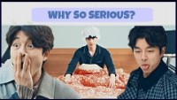

Favorite Korean Drama
Korean Music

Slide 10
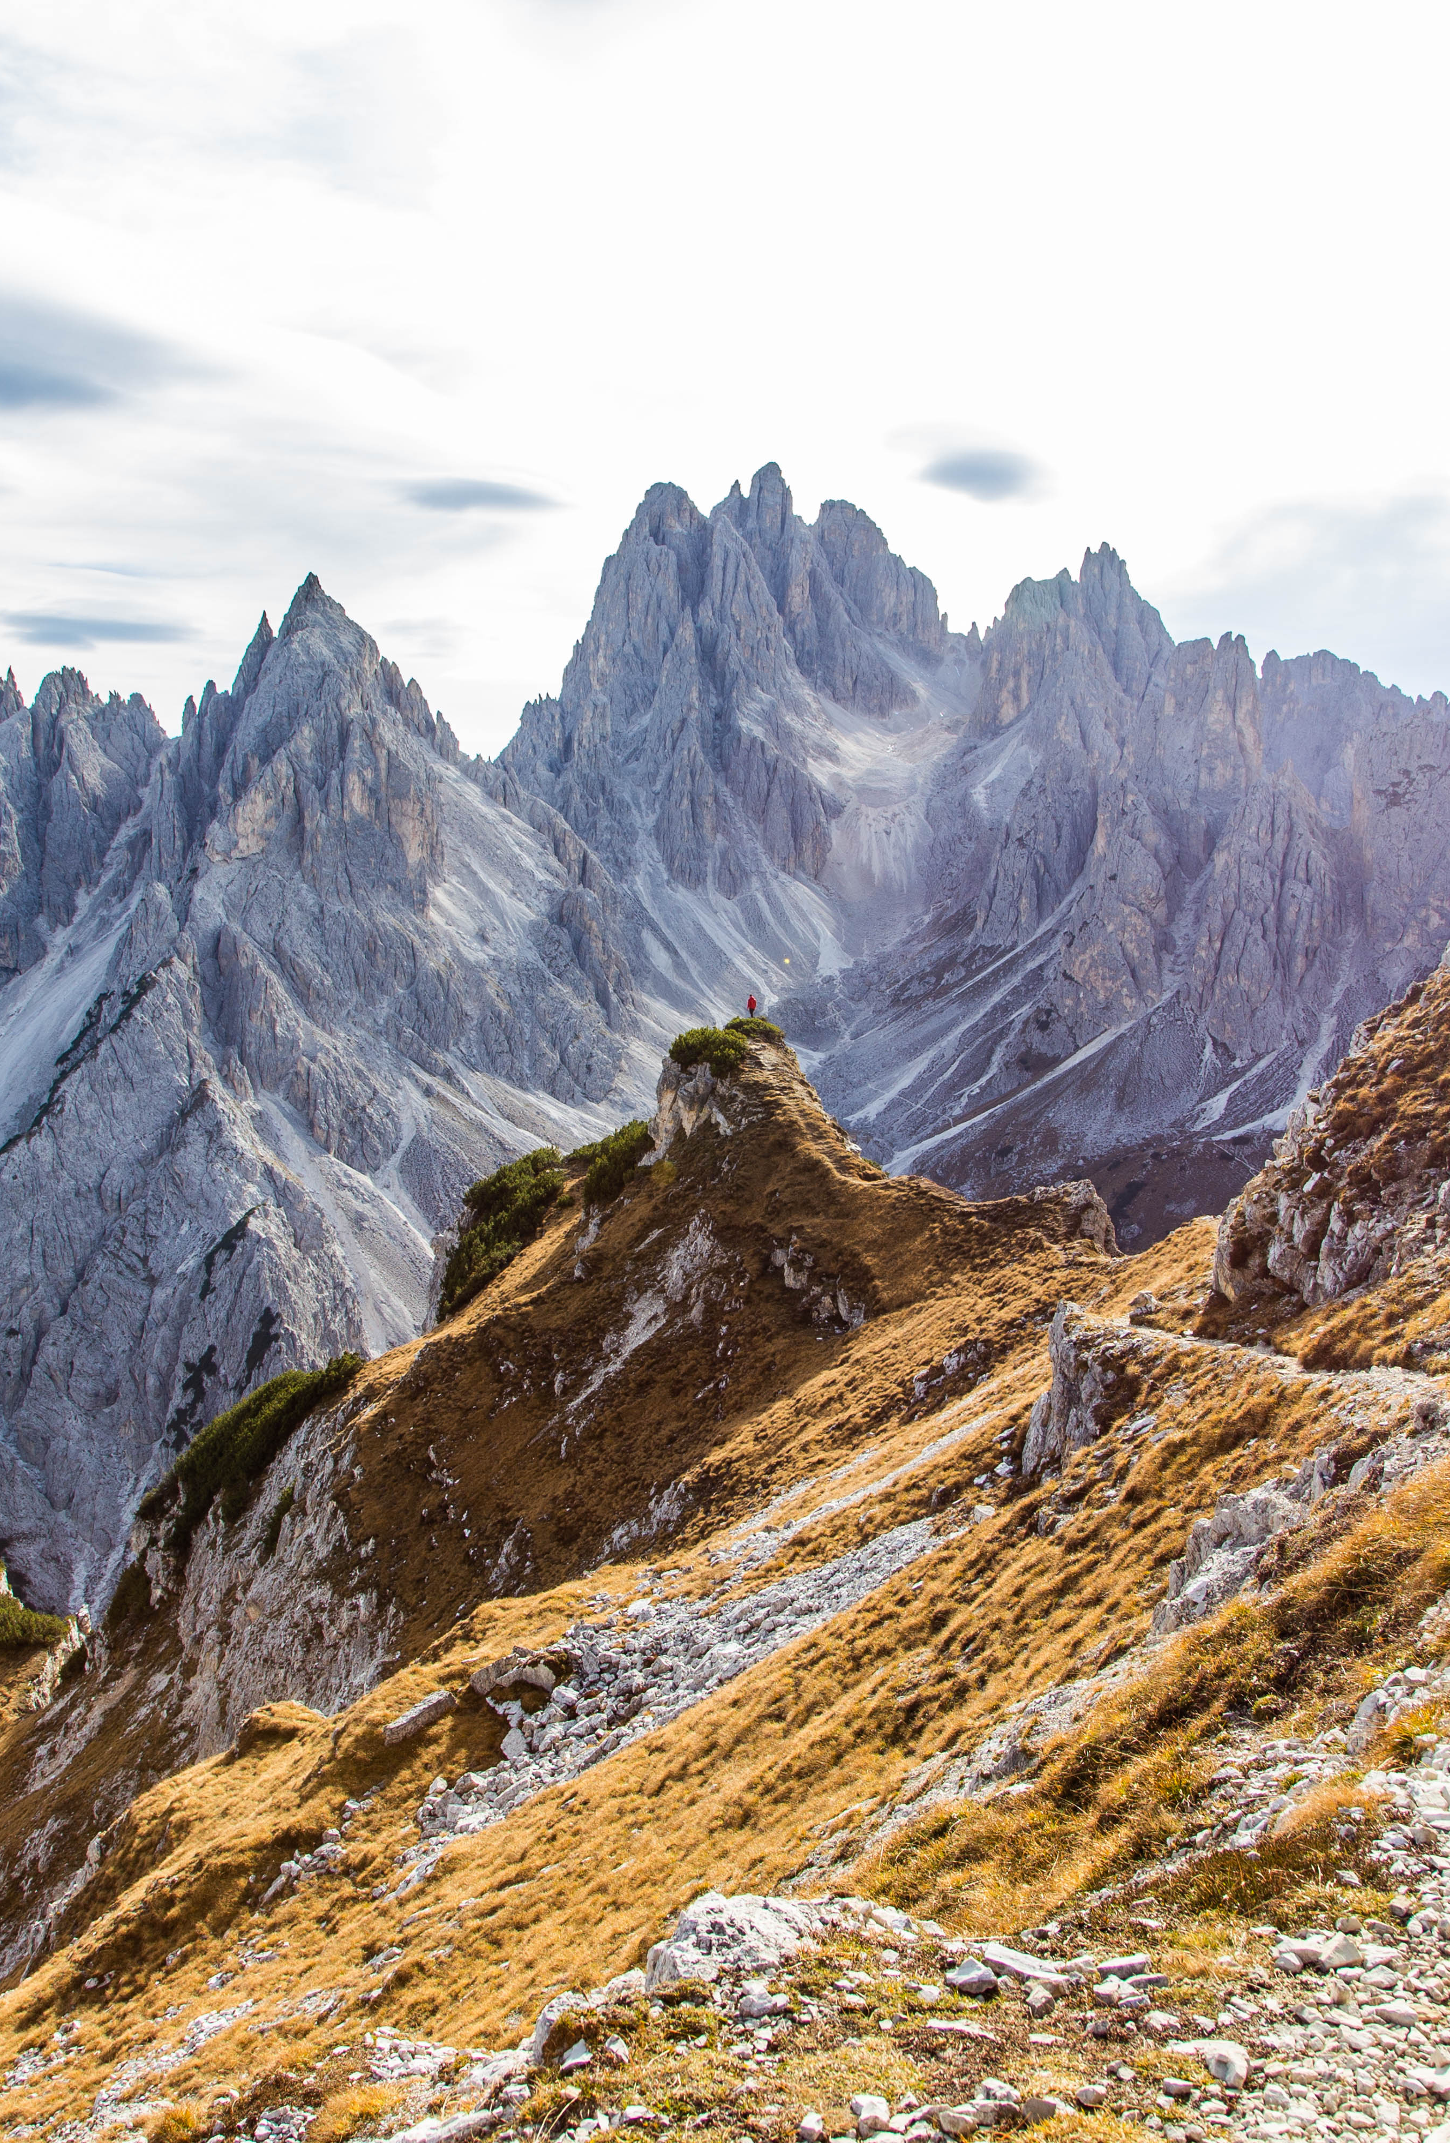
I have a lot of crazy dreams. Learning piano, archery, martial arts. Even French cuisine. I want to do a 9-5 job, but I also wish to be an entrepreneur. I want to write a horror story that becomes a bestseller. I also want to learn different languages and travel Antarctica.
In conclusion I am an 18-year-old exploring the world and finding my why

Slide 11
This was an assignment of the course (introduction to computer applications) in which I had to describe myself. This course even though was not my most strong forte I believe that it will always come in handy. As the world is digitalized in this era one should know how to represent their own data across the world so to find right opportunities for themselves. I thank Professor Waseem Arain for making this course productive and teaching us stuff that is mandatory for our skillset.
Zahra Mustafa
24054

